Slide 1

IE 643
Mid-term Review
Transfer Learning from Speaker Veriﬁcation
to Multispeaker Text-To-Speech Synthesis
170050005 - Yateesh Agarwal
170050031 - Shashank Kumar
170050050 - Mahesh Lomrar

Slide 2

Outline
Problem
Motivation
Background
Architecture
Datasets
Experiments
Results
Modifications
References

Slide 3

Problem at hand
Building a TTS (text-to-speech) system to generate natural speech which generalizes to a variety of speakers in a data efﬁcient manner.
Given few seconds of untranscribed reference audio from a target speaker synthesize new speech in that speaker’s voice, without updating any model parameters a.k.a. zero-shot learning

Slide 4

Motivation
Restore communication to users who have lost their voice and are are not able to provide many new training examples
Transferring voice across languages for more natural speech-to-speech translation
Generating realistic speech from text in low resource settings

Slide 5

Background
Earlier text-to-speech systems (TTS) were largely based on the concatenative TTS in which a very large database of short speech fragments is recorded from a single speaker which are recombined to form the complete utterances.
In 2016, DeepMind introduced a new parametric TTS called WaveNet which uses stack of casual convolutions that have various dilation factors. It produces great quality human like audio but required complex inputs like Linguistic Features, fundamental frequencies and Phoneme Durations.

Slide 6
In 2017, Tacotron model was introduced that only took raw character data as input to generate speech. It produced magnitude spectrogram which was further converted to speech using Griffin-Lim vocoder.
Tacotron 2 extended Tacotron network of converting character sequences to mel spectrogram and created a modified version of WaveNet to a vocoder to convert mel spectrogram to speech. Thus, combining Tacotron’s prosody with WaveNet’s audio quality gave a high MOS (Mean Opinion Score) but it only supported a single speaker.

Slide 7
In 2018, Deep Voice 3 introduced, was the first TTS system to scale to thousands of speakers with a single model. It proposed a fully convolutional encoder-decoder architecture which scaled up to support over 2,400 speakers from LibriSpeech. It learned a fixed set of speaker embeddings and therefore only support synthesis of voices seen during training.
In contrast, VoiceLoop proposed a novel architecture which can generate speech from voices unseen during training but required tens of minutes of transcripted speech

Slide 8

The Big Idea
In Jan 2019, a much celebrated paper “Transfer Learning from Speaker Verification to Multispeaker Text-To-Speech Synthesis” referred to as SV2TTS was published which just took few seconds of untranscribed audio and was able to clone it with high MOS.
Solution approach is to decouple speaker modeling from speech synthesis by independently training a speaker-discriminative embedding network that captures the space of speaker characteristics and training a high quality TTS model conditioned on the representation learned by the first network.

Slide 9
Architecture
Recurrent speaker encoder to compute a ﬁxed dimensional vector containing just the speaker characteristics from a speech signal
Sequence-to-sequence synthesizer which predicts a mel spectrogram from a sequence of grapheme or phoneme inputs
Autoregressive WaveNet vocoder to convert the spectrogram into time domain waveforms

Slide 10


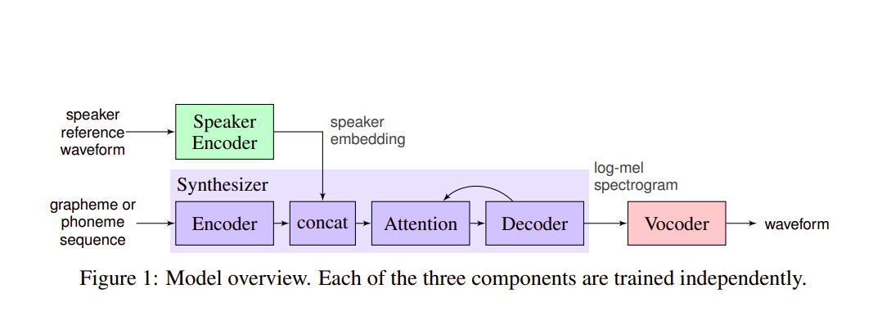
A picture is worth a thousand words!

Slide 11

Speaker Encoder
Uses a speaker-discriminative model trained on a text-independent speaker veriﬁcation task
Based on Generalised End-to-End Speaker Verification
Input is a 40-channel log-mel spectrogram
Stack of 3 LSTM layers of 768 cells, each followed by a projection to 256 dimensions
Final embedding is created by L2-normalizing the output of the top layer at the ﬁnal frame

Slide 12

Synthesizer
Extends Tacotron2 architecture to support multiple speakers as in DeepVoice2
Input is a character sequence with predicted mel-spectogram frames as output
Augments Tacotron2’s L2 loss with an additional L1 loss
Transfer learning is used without any changes to the encoder parameters

Slide 13

Vocoder
Autoregressive WaveNet vocoder as defined in Tactron2 architecture with 30-dilated convolutional layers
Uses mel-spectogram frames from the synthesizer as input
Output is time-domain waveforms

Slide 14

Datasets
VCTK and LibriSpeech datasets were used after downsampling and trimming to remove silence
Additional datasets used to improve performance were LibriSpeech Other, VoxCeleb and VoxCeleb2
The encoder was trained on a separate proprietary dataset apart from the above datasets

Slide 15

Experiments
Experiments are based on Mean Opinion Score (MOS)
The evaluation is performed based on two dimensions
Speech naturalness
Speech similarity
Other experiments performed
Speaker verification
Speaker embedding space
Number of speaker encoder training speakers
Fictitious speakers

Slide 16
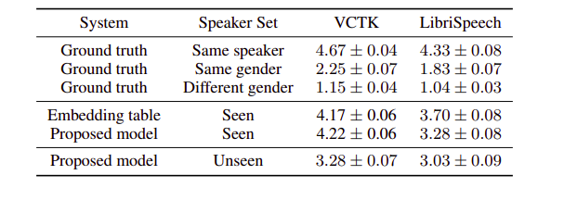
Speech Naturalness

Slide 17
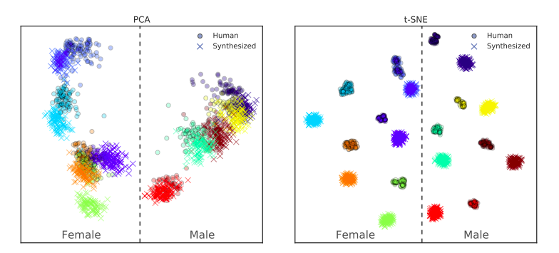
Speaker Embedding Space

Slide 18
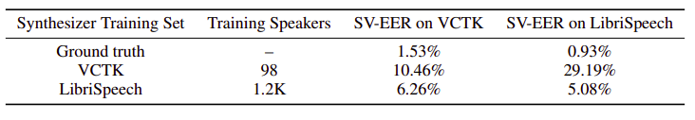
Speaker Verification

Slide 19

Replicating Results
We have set up the data and code of the experiments to train our model from scratch, but since its training requires about 2 months of GPU time, we had to use pre-trained model to test the model for possible improvements.
The results of experiment of the paper are evaluated by MOS (Mean Opinion Score) which is a crowdsourced based evaluation. So there is no way for us to know if the results are being accurately replicated or not.

Slide 20

Modifications
In synthesizer, we pass speaker embeddings from speaker encoder which should capture the speaker characteristics that are independent of sentence spoken. And then synthesizer uses it to generate mel spectrogram
In paper, while training the synthesizer on a pair of text transcript and target audio, the speaker embedding is generated using the same target audio
In the next slide, we compare how much output mel spectrogram changes when we change embedding from target audio to that of non target audio

Slide 21

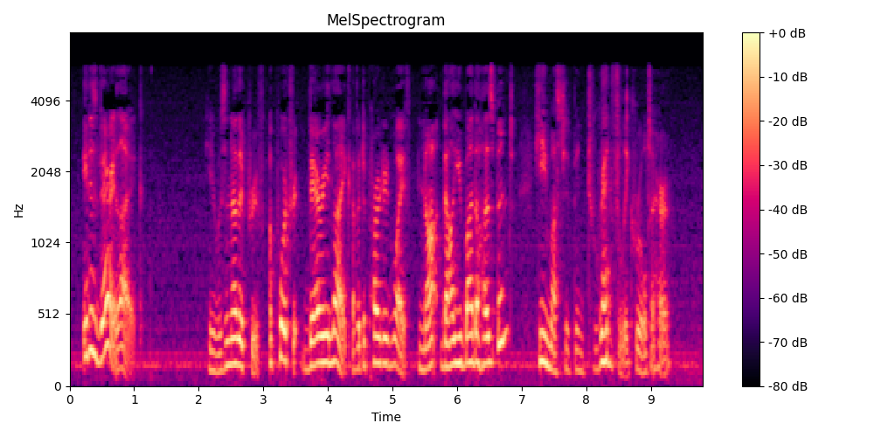
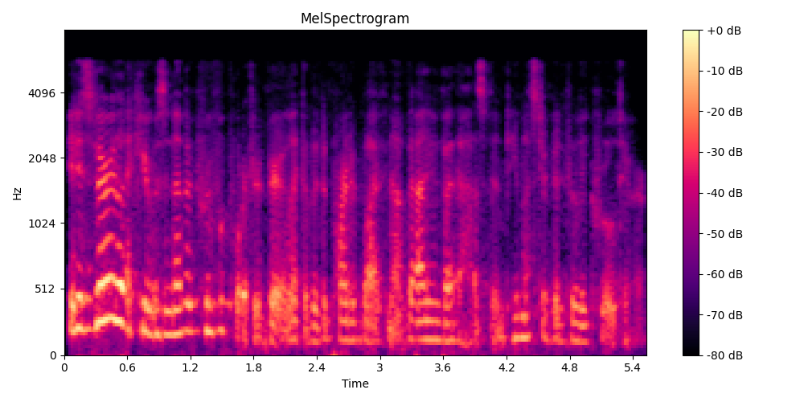
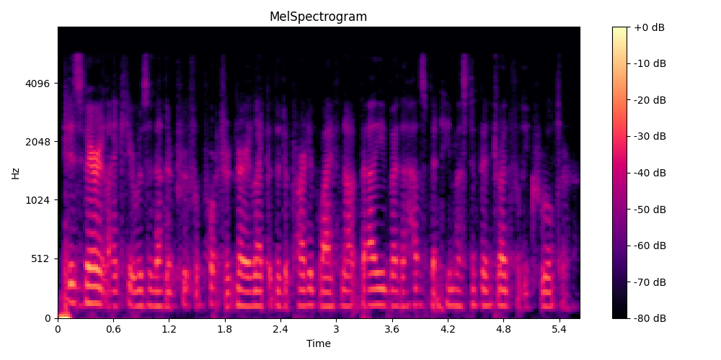
1
2
Mel spec. 1 is of target audio
Mel spec. 2 is output of em. from target audio
Mel spec. 3 is output of em. from another audio
We see that 1 and 2 are more similar than 1 and 3 (Fringing yellow pattern in 1&2). When one hears it, 2 does sound more natural than 3.
3

Slide 22
Thus we can say that some information about sentence does exist in speaker embedding itself
And since while both training and testing Tacotron 2, we use embedding from target audio itself, model simply uses this information and generates audio
Thus, decoupling of speaker modeling from speech synthesis is not proper which was the main aim of the paper. This leads to improper voice cloning which could be improved if synthesizer itself learns to generate this information
There are two ways to rectify this, we could either use a better SV model that stores only speaker characteristics in the generated embeddings. Or we can use a simpler and easier way of using average embeddings of a speaker while training and testing synthesizer to average out sentence information

Slide 23

Team Contribution

Slide 24

References
Github Repository
Generalized end-to-end loss for Speaker Verification
Tacotron2
DeepVoice2
Voice cloning using deep learning

Slide 25

Thank You!

